Slide 1

Design Document Prototype 1
Name: Edgar Pereira
Username: P010519P
Rage platformer prototype inspired by Geometry Dash platformer mode.
Focus is on precision, difficulty and simple visuals.

Slide 2
Game Mechanics
The game focuses on simple movement mechanics including horizontal movement, jumping and double jumping. These mechanics are intentionally simple due to requirements but still require precision and practice. The double jump allows for more complex level design and increases the skill ceiling. Collision detection ensures jumps reset properly, creating a consistent experience. The mechanics were tested many times, and adjusted to avoid floaty/slow movement and instead feel responsive and controlled.

Slide 3
Objectives
The objective is to complete each level by reaching the end without getting hot by a spike trap once. The player must avoid falling and time jumps correctly. The design encourages trial and error rather than any rewards or scoring systems. Difficulty increases across levels, forcing players to learn patterns and improve their timing whilst also introducing new traps and mechanics. The goal is to create a frustrating experience that gives the player a sense of satisfaction upon completion.

Slide 4
Core Gameplay Loop
The gameplay loop is based on repetition. The player starts a level, attempts to complete it, fails and retries. Over time the player learns the layout and improves. This loop creates frustration and satisfaction for players.
This gameplay loop is extremely simple and effective which allowed for a full game experience for players to be made with the limited time given
Start Level
Attempt
Fail
Retry
Complete

Slide 5
Level Design
Levels are designed with increasing difficulty. Early sections teach basic trap mechanics while later sections introduce more complex traps. Spacing and timing was planned to make the scaling hard at first but then extremely hard on later levels. Visual clarity will also be prioritized so players can clearly see obstacles, this will be done by using white boxes for every level and making the stage size the same between each level. Tutorial markers are used at the start to explain controls.
Platform
Universal level layout
Player
Trap
Exit

Slide 6
Systems Development
The project will include several needed systems such as pause menu, settings menu, audio system and post processing effects. I also want to add a music visualizer which reacts to audio using spectrum data, affecting bloom and lens distortion to make the music synergize with the game giving a cool experience. UI systems will likely require an EventSystem to function correctly. Another system that will also be needed is a death counter and maybe a taunting system that further rage baits players.

Slide 7
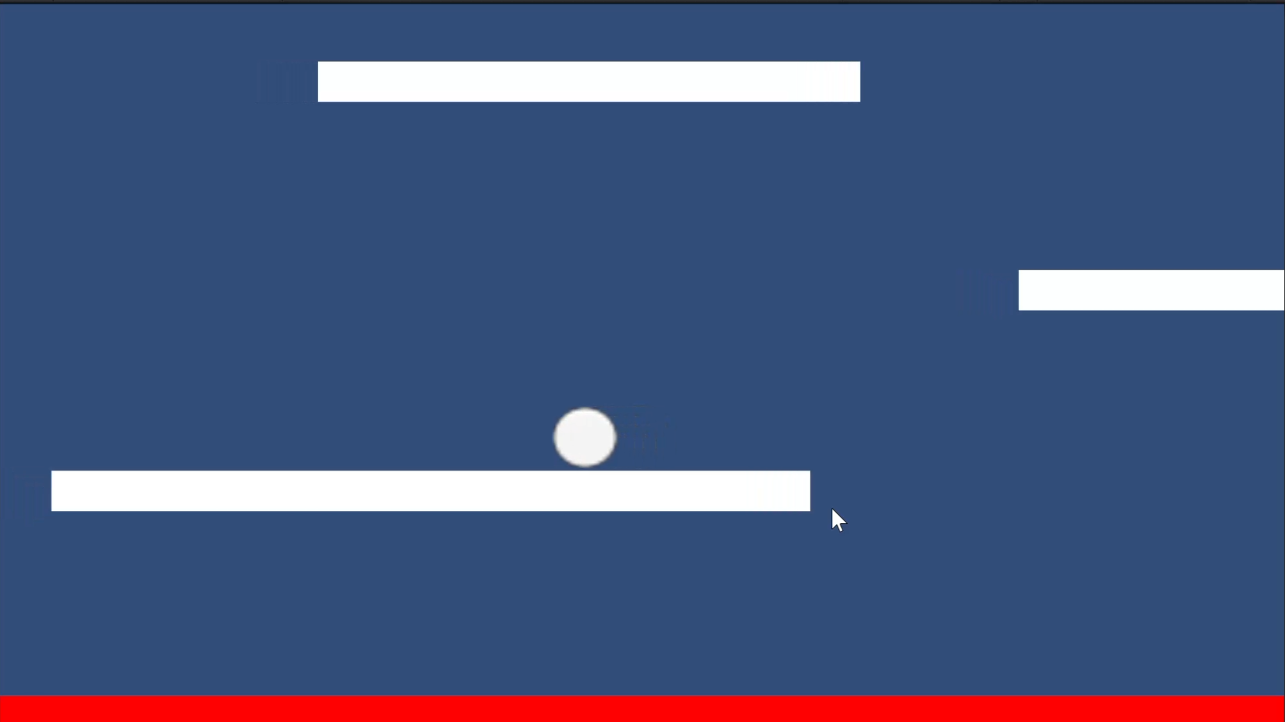
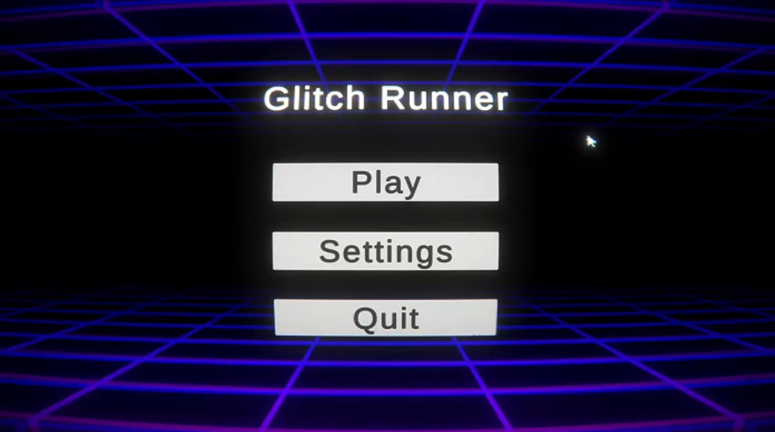
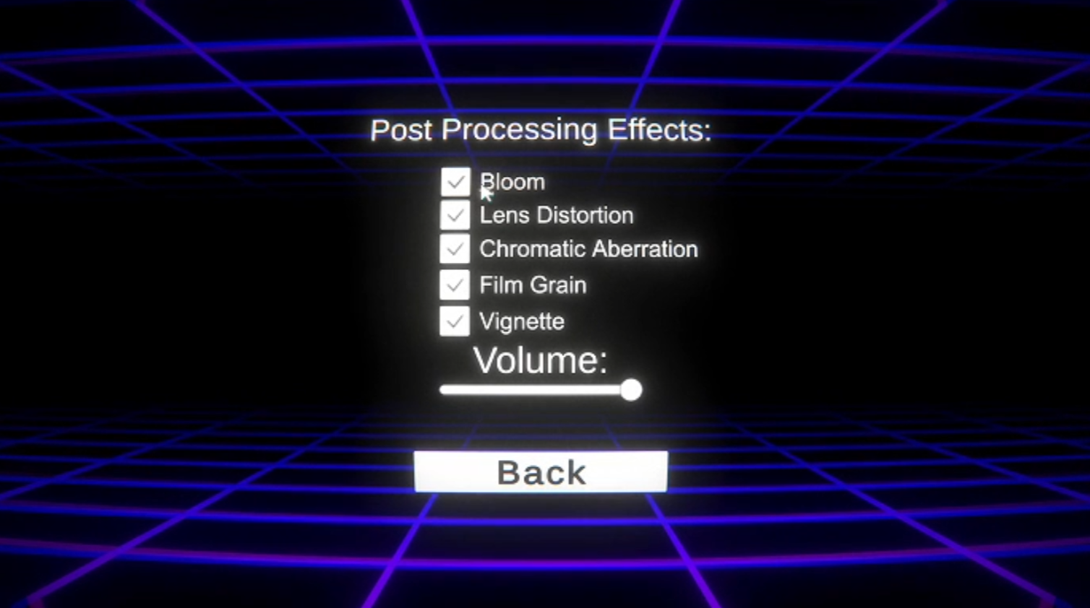
Annotated Screenshot
Example gameplay screens showing player, obstacles and UI. Annotations highlight core systems.
Exit
Platform
Player
Death zone
Title
Cursor design
Graphical
settings
Basic Main
menu features
Volume control

Slide 8
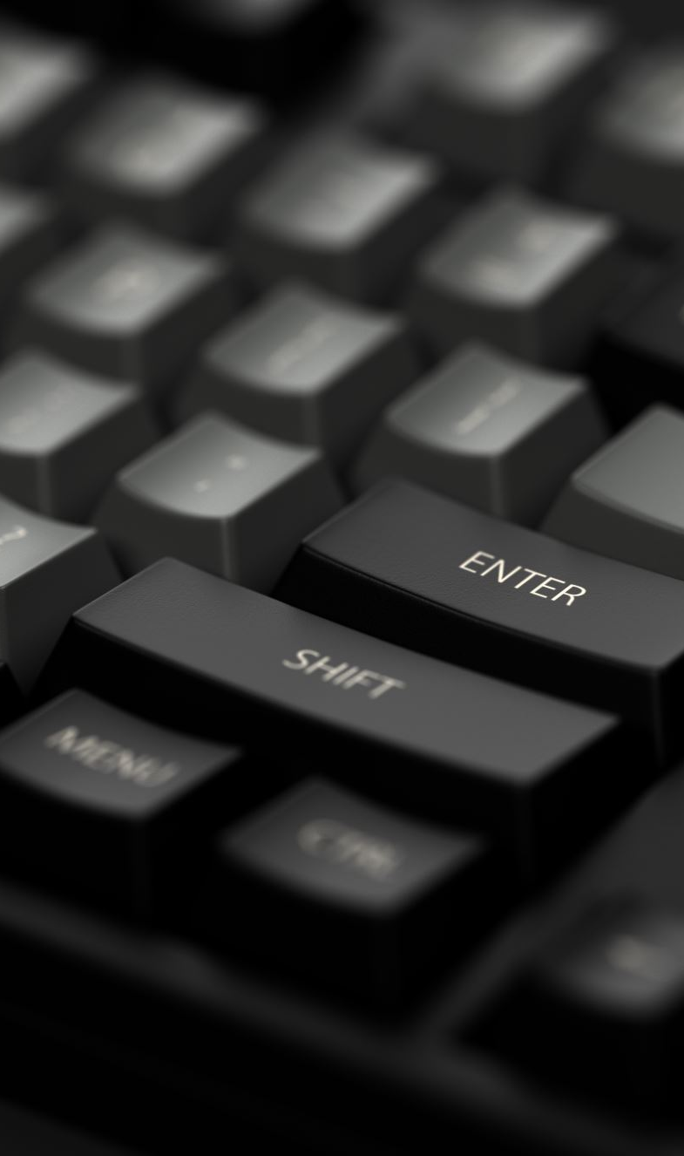
Problems and Solutions
Several issues occurred during development. UI did not work due to missing EventSystems. Cursor blocked buttons as I used a cursor image to have post processing affect the cursor so clicks did not register due to raycast settings. Settings did not save between scenes, which was fixed using PlayerPrefs or a persistent manager. I also had issues with level design as I was stuck on what to make that could be challenging for players, so I went back on geometry dash and used a few levels as inspiration form the new platformer mode. Each problem was tested and solved step by step.

Slide 9
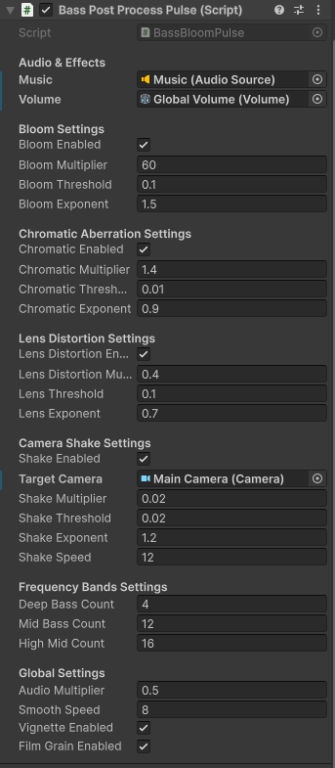
Bass Visualiser
My bass pulse script
One of the more complicated systems I created was the bass reactive visualiser for the levels. This system reacts to the music currently playing in the level and changes post processing effects based on the bass intensity. This helped make the game feel more dynamic and visually interesting.
The system works by reading frequency data from the audio source using Unity’s GetSpectrumData() function. Lower indexes in the spectrum array are bass frequencies, so I focused mainly on those values.
music.GetSpectrumData(spectrum, 0, FFTWindow.Blackman); float bass = 0f; for (int i = 0; i < 3; i++) { bass += spectrum[i]; }
The bass value is then used to affect visual effects such as bloom and lens distortion, etc. I also used smoothing to stop the visuals from spamming too aggressively.
currentIntensity = Mathf.Lerp( currentIntensity, bass * intensityMultiplier, Time.deltaTime * smoothSpeed );
This created a pulsing effect synced with the music and made the levels feel more and made the game seem like geometry dash.

Slide 10
Post Processing Effects
my game uses post processing effects to improve the design and exaggerate the rage style gameplay. Effects that I used were bloom, chromatic aberration, vignette, film grain, and lens distortion. The strongest effect is the lens distortion because it visually warps the screen to the beat of the music and kinda makes the game look retro. This system is connected to the bass visualiser, meaning effects become stronger during louder parts of songs. Example code:
lensDistortion.intensity.value = -currentIntensity;
Negative intensity values pull the screen inward which creates the warped effect seen during gameplay. Pause Menu and UI Systems The pause menu was made to also allow players to pause gameplay and adjust settings such as audio and visual effects. The system works by changing Unity’s timescale.
Time.timeScale = 0f; When paused, gameplay systems stop updating while the UI remains active. Resuming sets the timescale back to normal. Time.timeScale = 1f; I also added settings toggles for post processing effects such as bloom and lens distortion. These toggles directly enable or disable features from the bass visualiser script for players who don’t enjoy these effects.

Slide 11
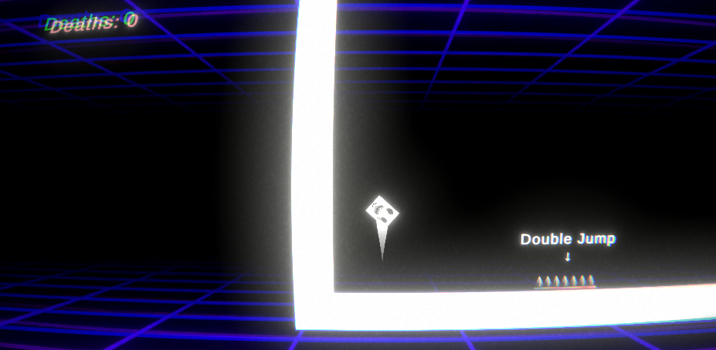
Testing and feedback
trap
Death Counter
player
tutorial
Player feedback played an important part during the development. Play testing showed that while players enjoyed the challenge, some mechanics were unclear at first which led to changes such as adding tutorial indicators and adjusting jump timing. The game achieved its intended goal as several testers became visibly frustrated whilst still trying to finish the levels, which matches the design goals of a rage platformer.
Some testers mentioned the difficulty scaling Is crazy but this was intended and I will be keeping this as is.

